Slide 1

Walchand College of Engineering, Sangli
Department of Information Technology
A
Presentation on
Performance evaluation of Fruit Fly Optimization
Algorithm on classical test problem set
Broad Topic: Evolutioanry Computation
Sub Topic: Evolutionary Algorithm
Presented By Dissertation Guide
Atul J. Kamble Dr. A. J. Umbarkar
M. Tech - II CSE(IT)

Slide 2
Outlines
Introduction
Fruit Fly Optimization Algorithm
Classical test problem set
Literature Survey
Research Gap
Research Objectives
Proposed Methodology
References

Slide 3
Introduction
Fruit Fly Optimization Algorithm (FFOA)
Proposed by (Pan,2012).
Inspired by the foraging behavior of fruit flies(Drosophila).
Has the ability to solve Complex Optimization Problems
Search pattern of fruit fly includes in sensitive osphresis [1] and flying towards location by vision.
Fig 1 : Drosophila body structure diagram[9]

Slide 4
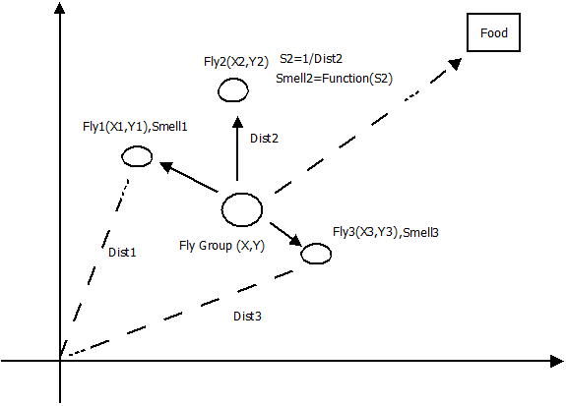
Schematic Representation
Fig 2 : schematic diagram of iterative search for food of fruit fly swarm [9]

Slide 5
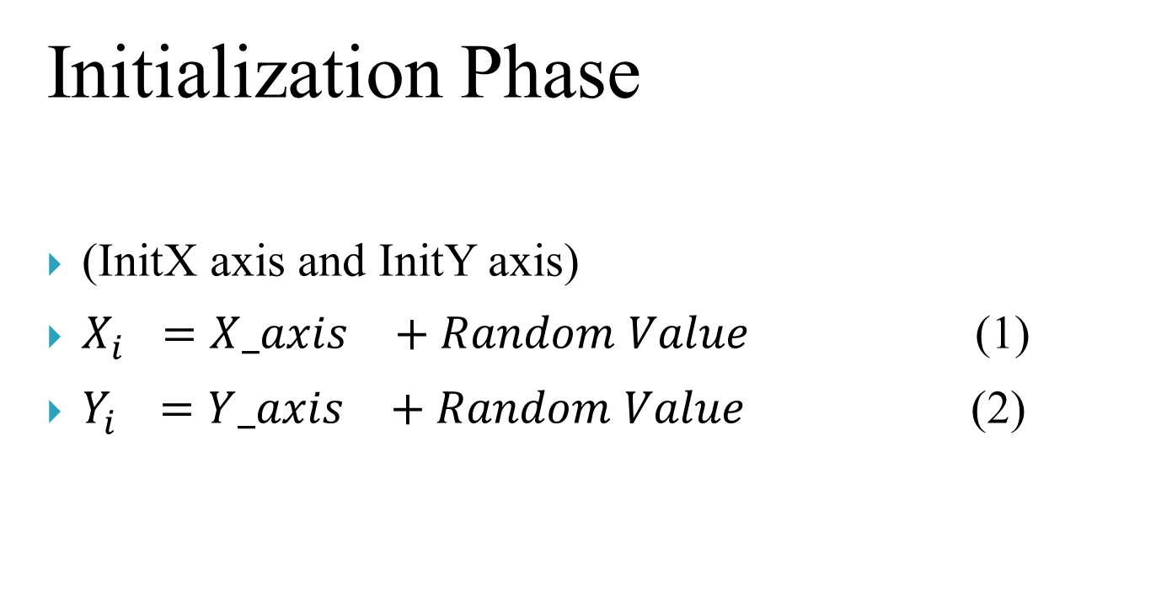
FFOA
Initialization Phase
(InitX axis and InitY axis)
$X_{i}^{}={X_axis}_{}^{}+Random Value$ (1)
$Y_{i}^{}={Y_axis}_{}^{}+Random Value$ (2)

Slide 6

FFOA
Path Construction Phase
${Dist}_{i}=\sqrt{X_{i}^{2}+Y_{i}^{2}}$ (3)
$S_{i}=\frac{1}{{Dist}_{i}}$ (4)

Slide 7

FFOA
Fitness Function Calculation Phase
${Smell}_{i}=$ ${Function(S}_{i})$ (5)
${[bestSmell}_{},bestIndex]=$ ${max(Smell}_{i})$ (6)

Slide 8
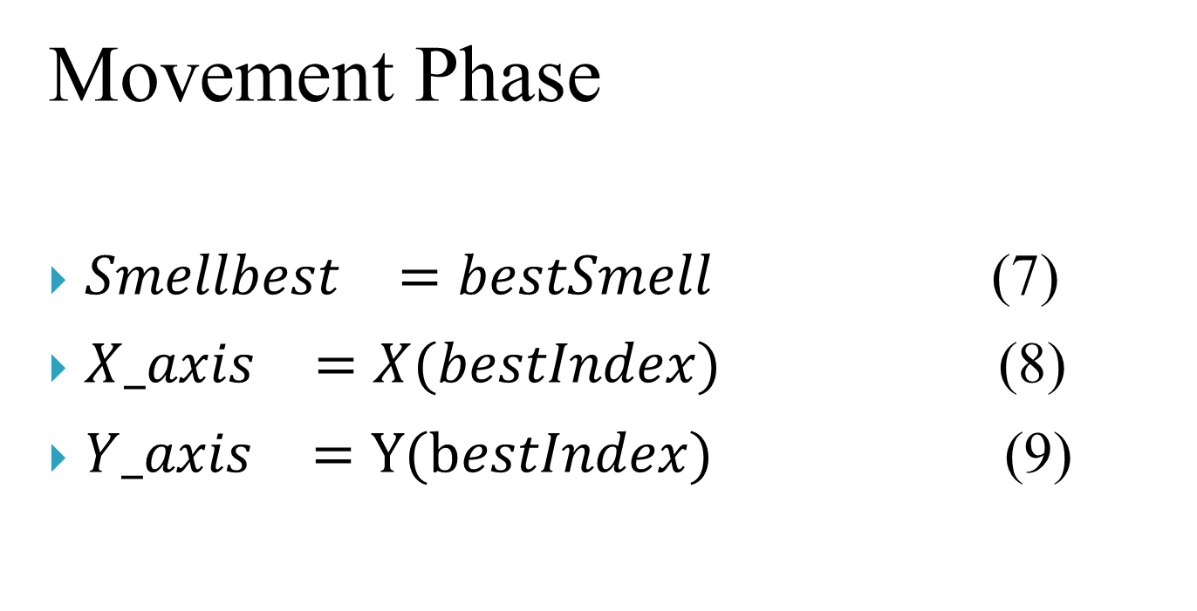
FFOA
Movement Phase
${Smellbest}_{}=bestSmell$ (7)
${X_axis}_{}^{}=X(bestIndex)$ (8)
${Y_axis}_{}^{}=Y(bestIndex)$ (9)

Slide 9
Literature Survey
In modern Iron and Steel Production Systems [1] production efficiency and profit can be increased by solving realistic hybrid flowshop rescheduling problem with the help of Hybrid Fruit Fly Optimization Algorithm.
The Resource Constrained Unrelated Parallel Machine Green Manufacturing Scheduling Problem (RCUPMGSP) [2] with the criteria of minimizing the makespan and the total carbon emission can be solved by Collaborative Multiobjective Fruit Fly Optimization Algorithm (CMFFOA).
Failure prognostics problem of electronic system, Fast Relevance Vector Machine (FRVM) [3] method based on Improved Fruit Fly Optimization Algorithm (IFFOA) is proposed.

Slide 10
Literature Survey
A multi-step prediction method for the network traffic based on echo state network optimized by quantum-behaved [4] Fruit Fly Optimization Algorithm.
Test point selection problem solved by Multi-Objective Fruit Fly Optimization Algorithm (MOFFOA) [6].
A classifier based on the Least Square Support Vector Machine (LS-SVM) [7] with Fruit Fly Optimization Algorithm (FFOA) for polarimetirc Synthetic Aperture Radar (SAR) image classification.

Slide 11
Research Gap
In contrast to the rapid development of algorithm design, performance investigation and comparison of algorithms have received little attention.
Several test problem suites which were developed for Multi-Objective Optimization have still been dominantly used in Many-Objective Optimization.
Since FFOA has not been implemented for classical test problem aiming to promote the research of Evolutionary Many-Objective (EMaO) [21] Optimization via suggesting a set of test problems with a good representation of various real-world scenarios.
CEC2015 is computational intensive to test the performance of Algorithm.

Slide 12
Research Objectives
To implement FFOA to the classical test problem sets (CEC 2013)
To check the analysis of result of classical test problem.
To apply FFOA for engineering optimization problem.

Slide 13
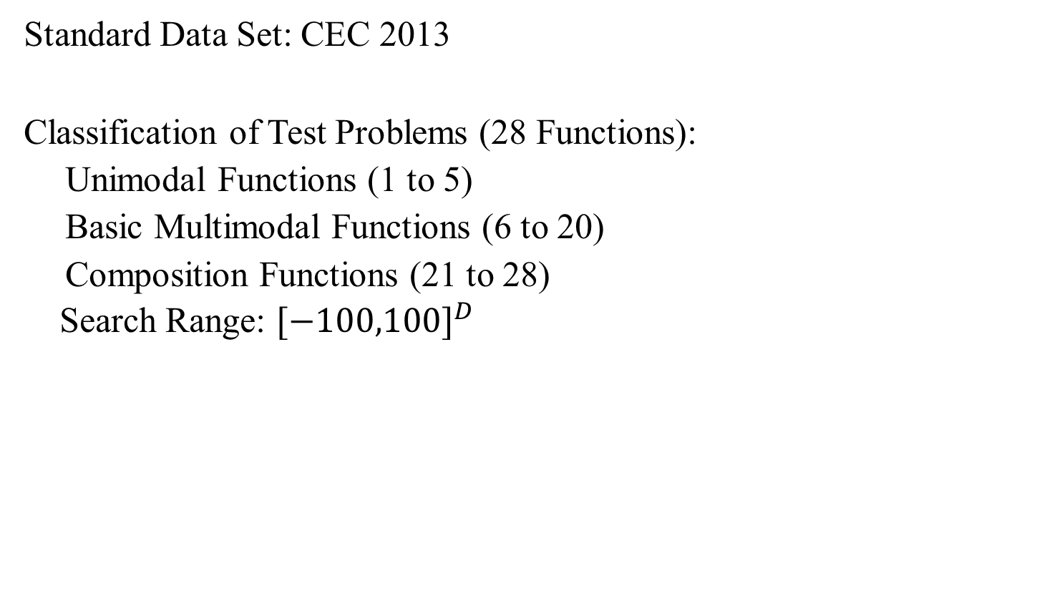
Data Set Used
Standard Data Set: CEC 2013
Classification of Test Problems (28 Functions):
Unimodal Functions (1 to 5)
Basic Multimodal Functions (6 to 20)
Composition Functions (21 to 28)
Search Range: ${[−100,100]}^{D}$

Slide 14
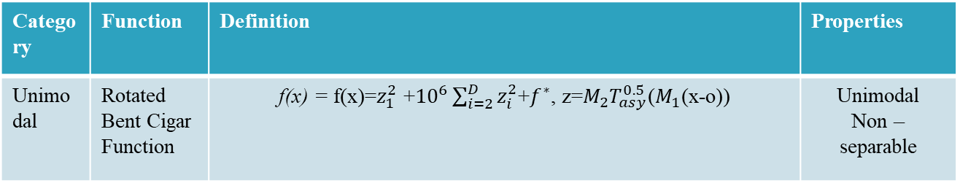
Test Functions
Category | Function | Definition | Properties
Unimodal | Rotated Bent Cigar Function | f(x) = f(x)=$z_{1}^{2}$ +${10}^{6}\sum_{i=2}^{D}{z_{i}^{2}}$+$f^{∗}$, z=$M_{2}T_{asy}^{0.5}$($M_{1}$(x-o)) | Unimodal Non – separable

Slide 15
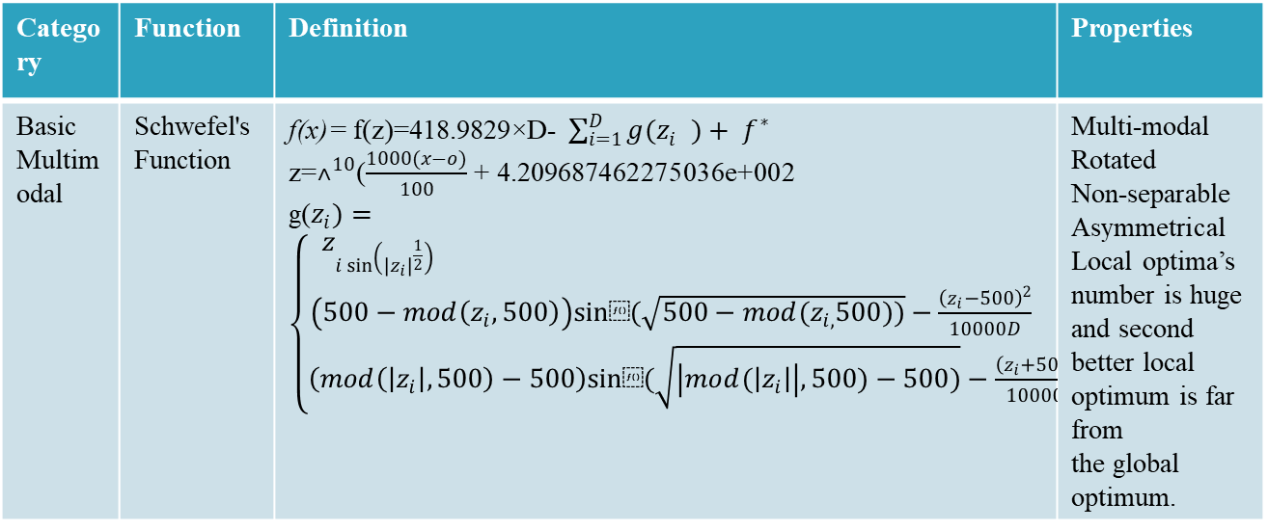
Test Functions
Category | Function | Definition | Properties
Basic Multimodal | Schwefel's Function | f(x)= f(z)=418.9829×D- $\sum_{i=1}^{D}{g(z_{i}^{}})+ f^{∗}$ z=$˄^{10}$($\frac{1000(x−o)}{100}$ + 4.209687462275036e+002 g($z_{i})=\left\{\begin{aligned}z_{i\sin\left({\left|z_{i}\right|}^{\frac{1}{2}}\right) if\left|z_{i}\right|≤500 } \\ \left(500−mod\left(z_{i},500\right)\right)sin⁡(\sqrt{500−mod(z_{i,}500))}−\frac{{\left(z_{i}−500\right)}^{2}}{10000D} ifz_{i}>500 \\ \left(mod\left(\left|z_{i}\right|,500\right)−500\right)sin⁡(\sqrt{\left|mod(\left|z_{i}\right|\right|,500)−500)}−\frac{{\left(z_{i}+500\right)}^{2}}{10000D} ifz_{i}<−500\end{aligned}\right.$ | Multi-modal Rotated Non-separable Asymmetrical Local optima’s number is huge and second better local optimum is far from the global optimum.

Slide 16
Test Functions
Category | Function | Definition | Properties
Composition Functions | Composition Function 1 (n=5,Rotated) | n = 5, σ= [10, 20, 30, 40, 50] λ= [ 1, 1e-6, 1e-26, 1e-6, 0.1] bias = [0, 100, 200, 300, 400] g1: Rotated Rosenbrock’s Function f6’ g2: Rotated Different Powers Function f5’ g3 Rotated Bent Cigar Function f3’ g4: Rotated Discus Function f4’ g5: Sphere Function f1’ | Multi-modal Non-separable Asymmetrical Different properties around different local optima

Slide 17
Parameter Setting
Sr. No. | Parameters | Value
1 | Design Variables | 10, 30, 50
2 | Population Size | 100
3 | Number of Iterations | 10000
4 | Number of Function Runs | 51
5 | Total Functions | 28
Sr. No. | Performance Evaluation
1 | Mean
2 | Best
3 | Worst
4 | Standard Deviation
5 | t-Test
6 | Optimized value
7 | Number of evaluations
Table 2: Parameters Used
Table 3: Performance Evaluation

Slide 18
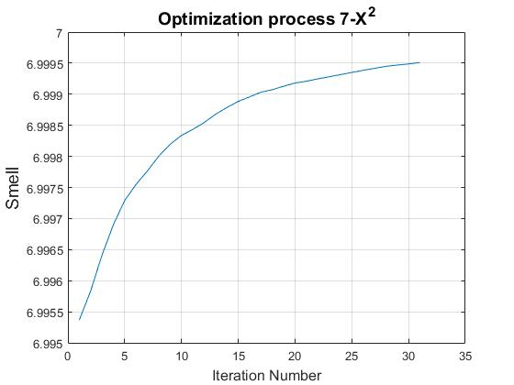
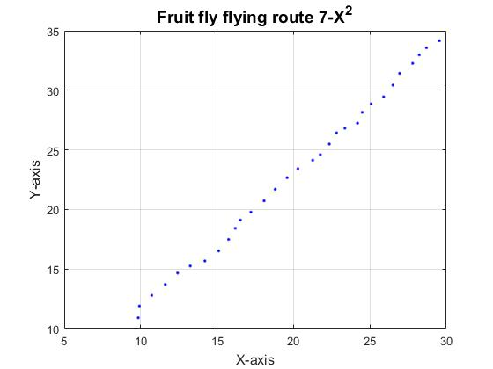
FFOA Result

Slide 19
DP3 and DP4 Plan
DP 3 Plan
Work on Remaining Objectives (2, 3, 4)
Literature Survey Paper
Attending Conferences
Improving plagiarism
DP 4 Plan
Writing paper
Writing result paper
Report Writing
Improving plagiarism

Slide 20
References
[1] J. Q. Li, Q. K. Pan and K. Mao,” A Hybrid Fruit Fly Optimization Algorithm for the Realistic Hybrid Flowshop
Rescheduling Problem in Steelmaking Systems,” in IEEE Transactions on Automation Science and
Engineering, vol. 13, no. 2, pp. 932-949, April 216.
doi:10.1109/TASE.2015.2425404
URL: http://ieeexplore.ieee.org/stamp/stamp.jsp?tp=&arnumber=7106574&isnumber=7447676
[2] X. L. Zheng and L. Wang, "A Collaborative Multiobjective Fruit Fly Optimization Algorithm for the Resource
Constrained Unrelated Parallel Machine Green Scheduling Problem," in IEEE Transactions on Systems, Man,
and Cybernetics: Systems, vol. PP, no. 99, pp. 1-11. doi:10.1109/TSMC.2016.2616347
URL: http://ieeexplore.ieee.org/stamp/stamp.jsp?tp=&arnumber=7605452&isnumber=6376248
[3] K. Wu, J. Kang and X. Wang, "Research on Failure Prognostics Method of Electronic System Based on
Improved Fruit Fly Algorithm and Grey Fast Relevance Vector Machine," 2016 International Conference
on Intelligent Networking and Collaborative Systems (INCoS), Ostrawva, 2016, pp. 94-98. doi:10.1109/INCoS.2016.65
URL: http://ieeexplore.ieee.org/stamp/stamp.jsp?tp=&arnumber=7695155&isnumber=7695003
[4] K. Ohnishi, A. Fujiwara and M. Koeppen, "Non-swarm intelligence search algorithm based on the foraging
behaviors of fruit flies," 2016 IEEE Congress on Evolutionary Computation (CEC), Vancouver, BC, 2016,
pp. 1509-1516. doi:10.1109/CEC.2016.7743968
URL: http://ieeexplore.ieee.org/stamp/stamp.jsp?tp=&arnumber=7743968&isnumber=7743769

Slide 21
References
[5] Y. Han, Y. Jing and K. Li, "Multi-step prediction for the network traffic based on echo state network optimized
by quantum-behaved fruit fly optimization algorithm," 2017 29th Chinese Control And
Decision Conference (CCDC), Chongqing, 2017, pp. 2270-2274. doi:10.1109/CCDC.2017.7978893
URL: http://ieeexplore.ieee.org/stamp/stamp.jsp?tp=&arnumber=7978893&isnumber=7978054
[6] Qingfeng Ma, Yuzhu He and Fuqiang Zhou, "Multi-objective fruit fly optimization algorithm for test point
selection," 2016 IEEE Advanced Information Management, Communicates, Electronic and Automation
Control Conference (IMCEC), Xi'an, 2016, pp. 272-276. doi:10.1109/IMCEC.2016.7867215
URL: http://ieeexplore.ieee.org/stamp/stamp.jsp?tp=&arnumber=7867215&isnumber=7867100
[7] S. Luo, K. Sarabandi, L. Tong and L. Pierce, "A LS-SVM-based classifier with Fruit Fly Optimization
Algorithm for polarimetric SAR images," 2016 IEEE International Geoscience and Remote Sensing
Symposium (IGARSS), Beijing, 2016, pp. 1859-1862. doi:10.1109/IGARSS.2016.7729477
URL: http://ieeexplore.ieee.org/stamp/stamp.jsp?tp=&arnumber=7729477&isnumber=7728980
[8] N. Mhudtongon, C. Phongcharoenpanich and K. Watanabe, "Linear antenna synthesis with maximum
directivity using improved fruit fly optimization algorithm," 2016 URSI International Symposium on
Electromagnetic Theory (EMTS), Espoo, 2016, pp. 698-701. doi: 10.1109/URSI-EMTS.2016.7571494
URL: http://ieeexplore.ieee.org/stamp/stamp.jsp?tp=&arnumber=7571494&isnumber=7571290
[9] Wen-Tsao Pan. A New Wvolutionary Computation-Fruit Fly Optimization Algorithm.,2016
[10] L. Polo-López, J. Córcoles and J. A. Ruiz-Cruz, "Fruit fly optimization algorithm for passive waveguide
devices," 2017 IEEE MTT-S International Conference on Numerical Electromagnetic and Multiphysics
Modeling and Optimization for RF, Microwave, and Terahertz Applications (NEMO), Seville, 2017, pp. 4345. doi: 10.1109/NEMO.2017.7964181
URL: http://ieeexplore.ieee.org/stamp/stamp.jsp?tp=&arnumber=7964181&isnumber=7964164

Slide 22
References
[11] S. Zhang, Y. Chen and Y. Geng, "Fruit Fly Algorithm Based on Extremal Optimization," 2016 12th
International Conference on Computational Intelligence and Security (CIS), Wuxi, 2016, pp. 534-537. doi: 10.1109/CIS.2016.0130
URL: http://ieeexplore.ieee.org/stamp/stamp.jsp?tp=&arnumber=7820521&isnumber=7820391
[12] A. Dey, T. Sarkar and S. Ali, "Fruit Fly algorithm based clustering protocol in wireless sensor networks,“
2016 9th International Conference on Electrical and Computer Engineering (ICECE), Dhaka, 2016,
pp. 295-298. doi:10.1109/ICECE.2016.7853914
URL: http://ieeexplore.ieee.org/stamp/stamp.jsp?tp=&arnumber=7853914&isnumber=7853836
[13] J. Jiang, H. Wang, G. Tang, L. Song and P. Chen, "Fault diagnosis method based on minimum entropy
deconvolution and fruit fly optimization algorithm," 2016 10th International Conference on Sensing
Technology (ICST), Nanjing, 2016, pp. 1-4. doi: 10.1109/ICSensT.2016.7796320
URL: http://ieeexplore.ieee.org/stamp/stamp.jsp?tp=&arnumber=7796320&isnumber=7796213
[14] Bo Xing,Wen-Jing Gao. A Innovative Computational Intelligence: A Rough Guide to 134 Clever Algorithms
Springer, 2016.
[15] Lin Wang, Yuanlong Shi, Shan Liu, An improved fruit fly optimization algorithm and its
application to joint replenishment problems, Expert Systems with Applications, Volume 42, Issue 9, 2015,
Pages 4310-4323, ISSN 0957-4174, http://dx.doi.org/10.1016/j.eswa.2015.01.048.
LINK: http://www.sciencedirect.com/science/article/pii/S0957417415000639
[16] H. Iscan and M. Gunduz, "A Survey on Fruit Fly Optimization Algorithm," 2015 11th International
Conference on Signal-Image Technology & Internet-Based Systems (SITIS), Bangkok, 2015, pp. 520-527. doi: 10.1109/SITIS.2015.55
URL: http://ieeexplore.ieee.org/stamp/stamp.jsp?tp=&arnumber=7400611&isnumber=7400513

Slide 23
References
[17] X. l. Zheng and L. Wang, "A Pareto based fruit fly optimization algorithm for task scheduling and resource
allocation in cloud computing environment," 2016 IEEE Congress on Evolutionary Computation (CEC),
Vancouver, BC, 2016, pp. 3393-3400. doi: 10.1109/CEC.2016.7744219
URL: http://ieeexplore.ieee.org/stamp/stamp.jsp?tp=&arnumber=7744219&isnumber=7743769
[18] H. Zhao, Q. Zhang, L. Zhang and Y. Wang, "A Novel Sensor Deployment Approach Using Fruit Fly
Optimization Algorithm in Wireless Sensor Networks," 2015 IEEE Trustcom/BigDataSE/ISPA, Helsinki,
2015, pp. 1292-1297. doi: 10.1109/Trustcom.2015.520
URL: http://ieeexplore.ieee.org/stamp/stamp.jsp?tp=&arnumber=7345428&isnumber=7345233
[19] J. Kang, K. Wu, K. Chi and X. Wang, "A Novel Multi-class Classification Approach Based on Fruit Fly
Optimization Algorithm and Relevance Vector Machine," 2016 International Conference on Intelligent
Networking and Collaborative Systems (INCoS), Ostrawva, 2016, pp. 402-406. doi: 10.1109/INCoS.2016.67
URL: http://ieeexplore.ieee.org/stamp/stamp.jsp?tp=&arnumber=7695209&isnumber=7695003
[20] L. Yin, X. Li, L. Gao and C. Lu, "A new improved fruit fly optimization algorithm for traveling salesman
problem," 2016 Eighth International Conference on Advanced Computational Intelligence (ICACI), Chiang
Mai, 2016, pp. 21-28. doi: 10.1109/ICACI.2016.7449797
URL: http://ieeexplore.ieee.org/stamp/stamp.jsp?tp=&arnumber=7449797&isnumber=7449793

Slide 24
References
[21] Ran Cheng, Miging Li, Ye Tian, Xingyi Zhang, Shengxiang Yang,Yaochu Jin Xin Yao.January 2016
Benchmark Function for CEC’2017 Competition on Evolutionary Many-Objective.
[22] Gozali, A. A., and Fujimura, S.,”Localization strategy for island model genetic algorithm to preserve
population diversity.” In Computer and Information Science ,Vol. 719, pp. 149-161. Studies in
Computational Intelligence; Vol. 719. Springer Verlag. doi: 10.1007/978-3-319-60170-0_11

Slide 25
THANK YOU.

Slide 26
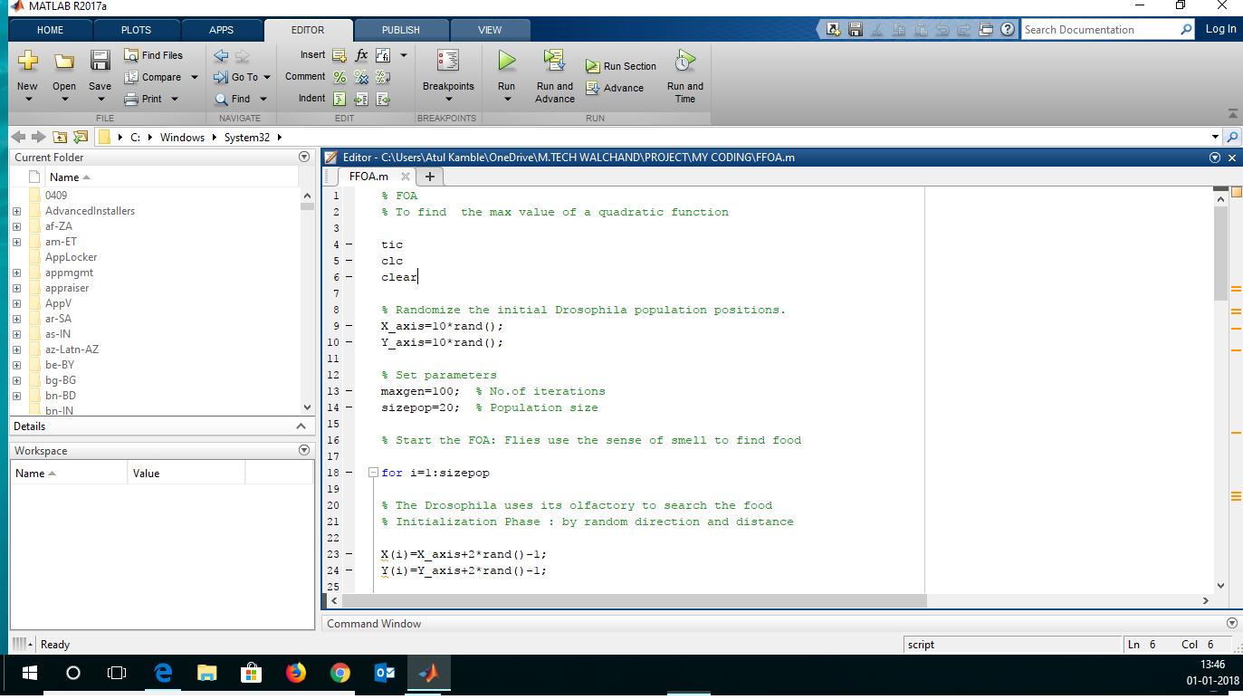
MATLAB CODE SCREENSHOT

